Slide 1
Eugene Rura, CPA,MBA
Matching skillset to position with capital planning department with Southwest Airlines:
Interview with Karen Thrasher

Slide 2

Greetings, this is Eugene.
This brief slideshow servers multiple (as is appropriate for a financial analyst specializing on multidimensional Business Intelligence) purposes.
First goal is to demonstrate the power of infographics in reinforcement of communication (since communication skills are specifically highlighted in the requisites for the position).
Second is to serve as a general timing guideline (since it is so easy get sidetracked discussing systems, concepts and examples).

Slide 3
My biggest advantage is in bringing three distinct skillsets necessary for this position:
Budgeting – while with AMX I served as liaison between departments and FP&A
While with Cost Modeling Department with Verizon actively worked with multivariate cost analytics
In all three positions actively worked with Business Intelligence Systems
Distribution of work experience in years over various positions held

Slide 4

Prepares the budget for and performs detailed variance analysis (with multiple cost drivers)
  Assist in Preparing Budgets/Annual Operating Plan
  Reviewing Actual results against Budget
  Explaining variances in both written and oral form
  Performing operational and financial decision support for Customer Departments and Leaders
Position requirements
My skillset
Budgets are predictions of future
Multivariate analysis is an attempt to understand the past
Business Intelligence systems provide information retrieval from data

Slide 5
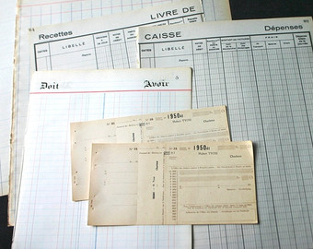
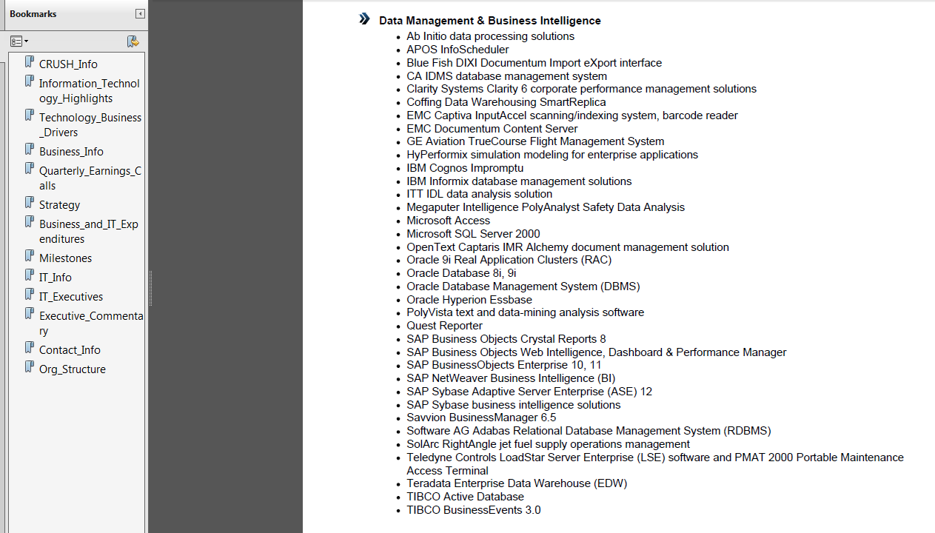
Why Business Intelligence systems?
1. Mentioned in the requirements (Hyperion)
2. New reality in which business is now done.
Traditional
CPA’s ERP
List of ERP/BI systems that SW uses according to Crush_Info. In layman’s terms – these are systems, where SW keeps its data.

Slide 6
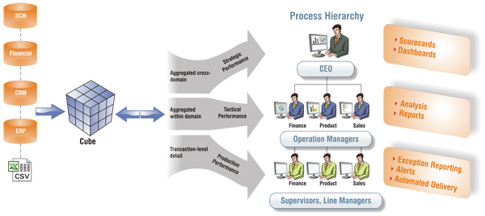

We have great IT, why do we need a CPA with programming skills to help departments to do budgets?
Multivariate analytics: create a cube
Use cube to present data and do drill-downs
Use cube to create dashboards and time-series
Search cube for significant factors to explain variances

Slide 7
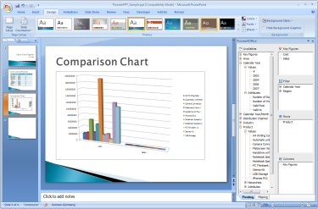
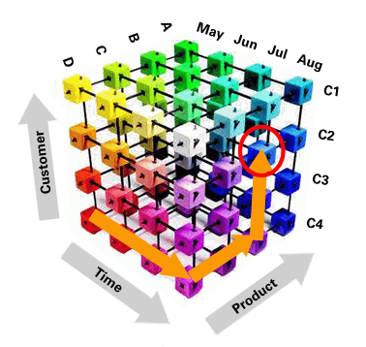
(Just in case) – what in the world is a cube?

Slide 8
Thank you for your time

